Slide 1
Telemilitary
Indie Game Telemetry & Progression Balancer

Slide 2
Problem Statement
Why balancing the game is difficult
Hard to see which stages are too easy or too hard
No clear insight into why players fail( memory load, time pressure, randomness)
Different play styles may be treated unfairly
Designers can’t easily spot frustration or drop-off points
What this causes
Guesswork balancing
Unfair difficulty spikes
Poor progression flow
Players quitting early
Without telemetry, we can’t understand player behaviour, diagnose difficulty issues, or balance the game fairly.

Slide 3
Project Goal
A telemetry-enabled gameplay
Dashboard for difficulty, fairness and progression
Balancing suggestions + simulation
Extensible system for new events/stages
A handover pack for maintainers

Slide 4
What Was Delivered in Sprint 1
Game concept and telemetry-driven balancing problem
How we capture, validate, and store telemetry events
Dashboard views: funnels, spikes, progression, and fairness indicators
Balancing toolkit: rule suggestions, simulation previews, and decision logging
Testing, handover pack, and evaluation highlights

Slide 5
Sprint 2 Goals
Board & Card: Dynamic grid (rows/cols); mismatch shake + replay “ghost” states, a core flip/match logic to remain unchanged
Mobile layout: Stable board sizing (viewport + HUD reserve), safe areas, better controls & streak UI that don’t collapse
Freeze & timer: No mismatch penalty or timeout loss while frozen, the logic/UI is in sync and an honest telemetry
Stage wins: Total tokens (stage + streak bonus); breakdown in modal; free Hint callout when it applies

Slide 6
Sprint 2 Deliverables
Playable browser memory game with 10 stages across easy/balanced/hard configs
Telemetry pipeline captures and validates gameplay events in Flask + SQLite
Designer dashboard supports funnel, spikes, progression, fairness, and comparison views
Rule-based balancing toolkit with simulation and decision logging

Slide 7
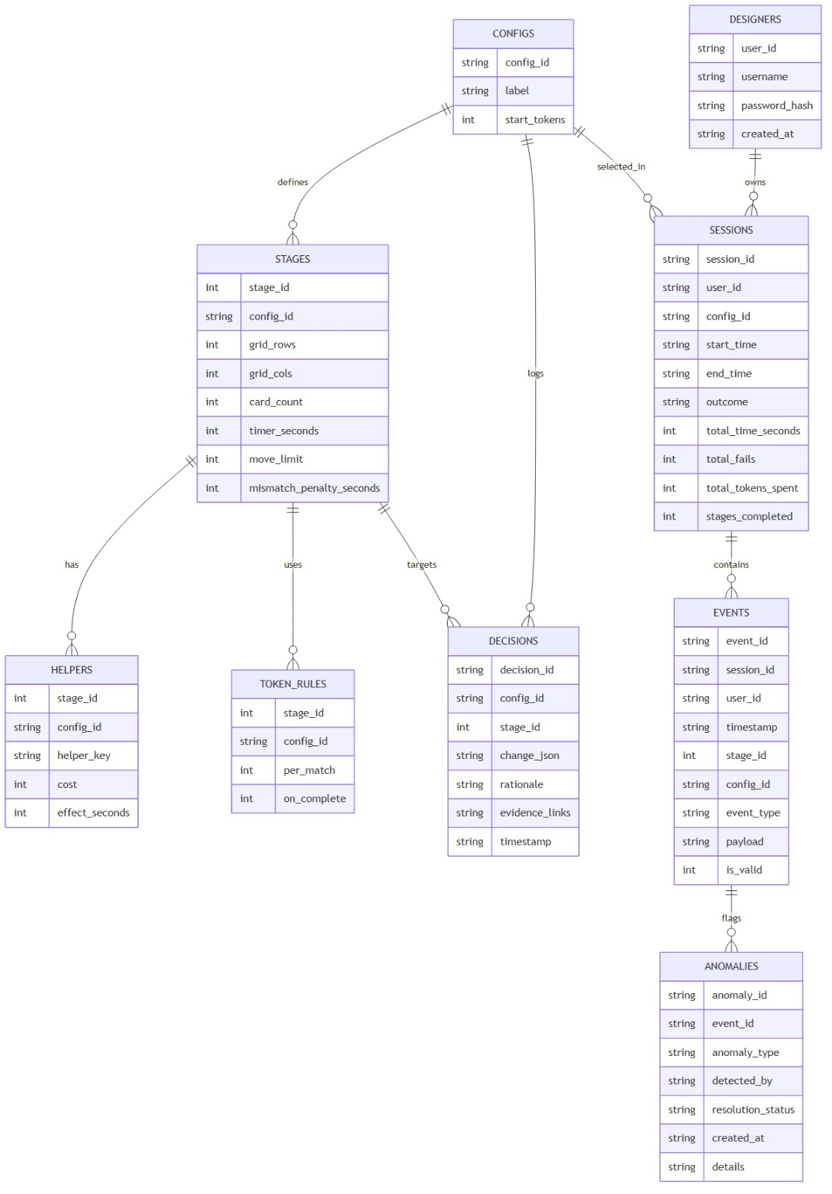
Architecture
Client(Game Frontend)
Game engine + UI
Stage config loader
Telemetry client (sends events)
Server (Backend Logic)
Telemetry processing
Metrics + difficulty analysis
Balancing logic + suggestions
Session + game config management
Shared Layer
Shared types
Stage configs
Telemetry shapes
Data Models
Stages
Events
Sessions
Decisions
Balancing rules

Slide 8
Application Screenshots

Slide 9
Testing Overview
37
8
8
automated tests passing
test files
manual E2E scenarios
Test Coverage Breakdown:
• test_auth.py (6) — Registration, login, password validation
• test_rbac.py (9) — Player/viewer/designer access control
• test_events.py (8) — Telemetry event validation & edge cases
• test_export.py (3) — CSV export headers, content, filtering
• test_sessions.py (3) — Session start, end, summary
• test_balancing.py (2) — Suggestions & simulation
• test_ingestion.py (2) — Event storage & anomaly logging
• test_metrics.py (4) — Funnel, stats, progression, fairness

Slide 10
Results vs Success Criteria
Difficulty Spikes: The system can correctly flag hard stages
Fairness: It can detect large gaps between player types
Balancing Impact: Suggested changes helps to reduce fail rate and improve play progression
Progression Flow: A smoother funnel between stages
Usability: Designers can identify issues quickly via UI sections

Slide 11
Evaluation Highlights and Limitations
Detection validity: rules identify known difficult stages in seeded data
Fairness analysis: segment gaps are measurable and can drive mitigations
Balancing effectiveness: simulation previews expected progression improvements
Limitation: simulation is lightweight and should be validated with further playtesting
Limitation: final manual testing evidence should be packaged in testing_evidence.pdf

Slide 12
Client Handover Pack
The handover pack is a single document meant for anyone else who takes over the project in the future. Outlining how they could extend the system
Within the `docs` folder under the name `handover-pack`

Slide 13
New event type
Add event name in backend/models.py -> EventType
Define required keys in backend/logic/telemetry.py -> required_payload_fields
Emit event from client/src/pages/Game.jsx -> trackEvent(...)
optionally, backend/tests/test_events.py & data/seed_telemetry.py

Slide 14
Potential Risks and the Next Steps
Risk: over-tuning for one segment can hurt fairness for others
Risk: telemetry quality degrades insight quality if validation rules are bypassed
Next step: continue scenario-based balancing cycles with decision audit trail
Next step: extend manual E2E evidence pack and maintainer runbook details

Slide 15
Team Contributions
Member | Role | Key Contributions
Lara Eksi | Project Lead | Coordination, report, ethics, process docs
John Jerome | Backend Lead | Flask API, telemetry pipeline, metrics logic
Siddhant Krishnan | Backend Dev | Balancing simulation, seed data, testing
George Littler | Frontend Lead | React game engine, board, HUD, stages
Kimberly Emuophedaro | Frontend Dev | Dashboard, designer views, RBAC UI
Angel Gebretensai | Testing/Docs | Manual E2E testing, handover docs
Su Bektas | Testing/Docs | Security checklist, risk register, presentation

Slide 16
Live Demo
https://telemilitary-1.onrender.com/
GitHub: github.com/laraeksi/Telemilitary

Slide 17
Q&A — Thank You!
Key Metrics at a Glance:
• 10 stages × 3 difficulty configs × 15 event types
• 600 sessions, 102 pseudonymous users, 150+ anomalies in seeded data
• 37 automated tests + 8 manual E2E scenarios
• 4 analytics views: funnel, spikes, progression, fairness
• Demo: https://telemilitary-1.onrender.com/
• Repo: github.com/laraeksi/Telemilitary (tag: v1.0.0-cw2)

